Slide 1
Library – Community Center

Slide 2
Notes:
The modern library model proposed for the context of Moldova is the public library as a community center to meet the needs and fulfill the expectations of each community member and stakeholder. Further on are presented the various expectations stakeholders have towards the library.

Slide 3
Expectations
Local Public Authorities
Enhance the visibility of the community;
Develop and preserve the community memory ;
Promote the community personalities;
Develop the “sense of the community”
Notes:
Local public authorities represent the main partner of the public library in the community, thus they have various expectations. LPA see the public library as an active promoter of community personalities, steward of local history, serving as repositories of collective community memory, developer of the “sense of the community”, bringing the members closer and enhancer of the community visibility.

Slide 4
Expectations
Community Members (shared by all groups)
Digital alphabetization;
Community civic education;
Free access to information, Internet;
Space for hobby and talent fulfillment.
Notes:
The community members share general expectations towards the library, which could be classified in three general categories: i) access to information on paper and online platform, ii) provision with training opportunities to cover the digital divide, contribute to digital literacy of community members and civic education, and iii) make available the institution’s place to hobby and talent fulfillment.

Slide 5
Expectations
Children
Cognitive activities and skills development using information technologies in such as: design, painting, coding, animation, programming, library website or blog creation ;
Homework assignments using information technologies technologies;
Notes:
Children are most loyal patrons of public libraries. They expect from the library/librarian to benefit from support in completing their homework assignments outside the class/school and be involved in skills development and cognitive activities by using the information technology.

Slide 6
Expectations
Adults
Group activities (hobbies – flowers, crochet, embroidery, cooking, interior design, bee-keeping, other handcrafts, etc.);
Specialized discussion clubs;
Digital literacy trainings;
Notes:
Adults would be very much interested in a library offer which provides them with the space to spend time, communicate, and socialize. The libraries could organize various clubs with specific topics, groups focused on quilling activities or support them with IT training to facilitate online communication with relatives/friends abroad.

Slide 7
Expectations
Groups with special needs
Social inclusion of various groups
regardless of age, gender, ethnicity,
ability or social background
Notes:
The community members which have special needs expect the library to facilitate their social inclusion. They could be children with disabilities, children from Roma families or children coming from mono-parental families. Another group of people could be seniors which could be involved in development of local history or community memory (e.g. retired teachers may be involved as volunteers to provide guidance for school children when completing their homework assignments)

Slide 8
Expectations
Library
Visibility within the community
Integration as a community actor
Library – community connector
Notes:
In the process of modernization the library and the librarian have their own expectations. The library would like to be more visible as an institution, be perceived as a community actor and be transformed into a community connector.

Slide 9
Expectations
Librarians
Civic engagement;
Professional engagement ;
Notes:
Librarians have also expectations in the modernization process. Especially they would like to be involved in the community issues as citizens and as representatives of a community institution, be involved in development and implementation of various community initiatives, activities and projects.

Slide 10
Expectations
Librarians
Professional development opportunities
Professional&social acknowledgement
Personal satisfaction
Notes:
Librarians also have expectations in the process of library modernization and as employees of a modern library. They want to benefit from trainings, workshops, and various professional development opportunities which would enhance their knowledge, skills and abilities. Librarians need professional and social acknowledgement from their funders (local public authorities), supervisors, community members, partners and other. And, librarians need to be personally satisfied with their job, achievements and outcomes.

Slide 11
Community Relations
Ongoing promotion of library value and impact on patrons and community members
Involvement and loialization of various groups of populations
Creation and advancement of strategic partnerships with community institutions
Notes:
Each modern librarian should develop competencies in establishing and advancing the community relations through showing the impact and the value of the libraries (the impact could be evaluated through an assessment of library services and activities on patrons), usage of various methods to attract users (professional groups) and gain their support, maintaining good relations with public authorities and decision makers and establishing partnerships with other community institutions and organizations.

Slide 12
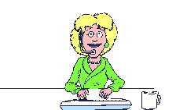
6 Steps to Community Success:
activity
availability
attention
accessibility
responsibility
attitude
Notes:
A librarian should keep in mind that there are 6 steps which ensure community success. The steps are totally up to the librarian willing to modernize the library.

Slide 13
ACTIVITY
Values determine priority
Priorities determine objectives
Objectives determine activities.
Notes:
An active modern library is defined by a motivated and goal-oriented modern librarian which has on his/her mind the library values which determine the priorities leading to activities.

Slide 14
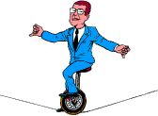
AVAILABILITY
Library services are available anytime, anywhere, and for anyone;
Priority is given to activities that are important for the community;
Notes:
A modern librarian should ensure that the library is available anytime for anyone. Priorities should be given to those activities which are important for the community members and patrons. Depending on the activities the librarian is able to manage his/her own schedule.

Slide 15
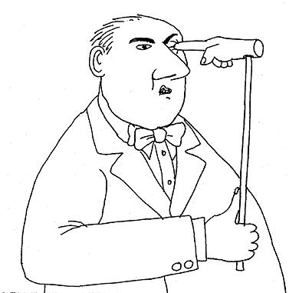
ATTENTION
Prioritization and concentration
Real necessity vs temporary necessity
Notes:
A modern librarian should master the art of concentration and prioritization and should make clear distinction between what represents a real need of the library and its patrons vs a temporary need requiring much attention and involvement.

Slide 16
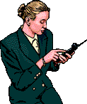
ACCESSIBILITY
Well-functioning system
Notes:
A modern librarian has a well-functioning system in place to support with planning, implementation, assessment and communication on library’s activities.

Slide 17
RESPONSABILITY
Commitment and liability
Notes:
A modern librarian strives for ongoing development, is committed to and responsible for each library activity, initiative and service. A modern librarian bears full responsibility for library’s successes and failures.

Slide 18
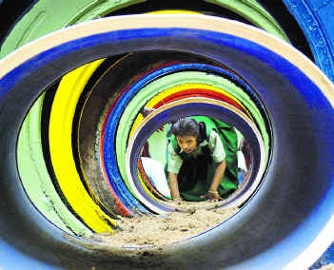
ATTITUDE
Ongoing learner
Motivation and determination
Pro-activeness
Notes:
A modern librarian benefits from each available training opportunity and learning program, is motivated, determined and with a positive attitude. Thinks and acts quickly, is proactive and reacts promptly.

Slide 19
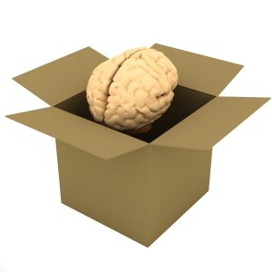
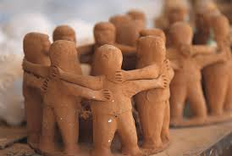
Being active within the community depends on your mindset and on “sense of the community” feeling

